Slide 1

Team Name: Coder Sena
Participants:
1.) Harsh Verma (Team Leader) ~ Student at NIT Hamirpur, 1st year, Branch: Electrical
2.) Shivam Goel ~ Student at NIT Hamirpur, 1st year, Branch: Mechanical
3.) Harish Kumar ~ Student at NIT Hamirpur, 1st year, Branch: ECE
Tech Stack:
Kotlin, Jetpack Compose, Xml, Firebase

Slide 2
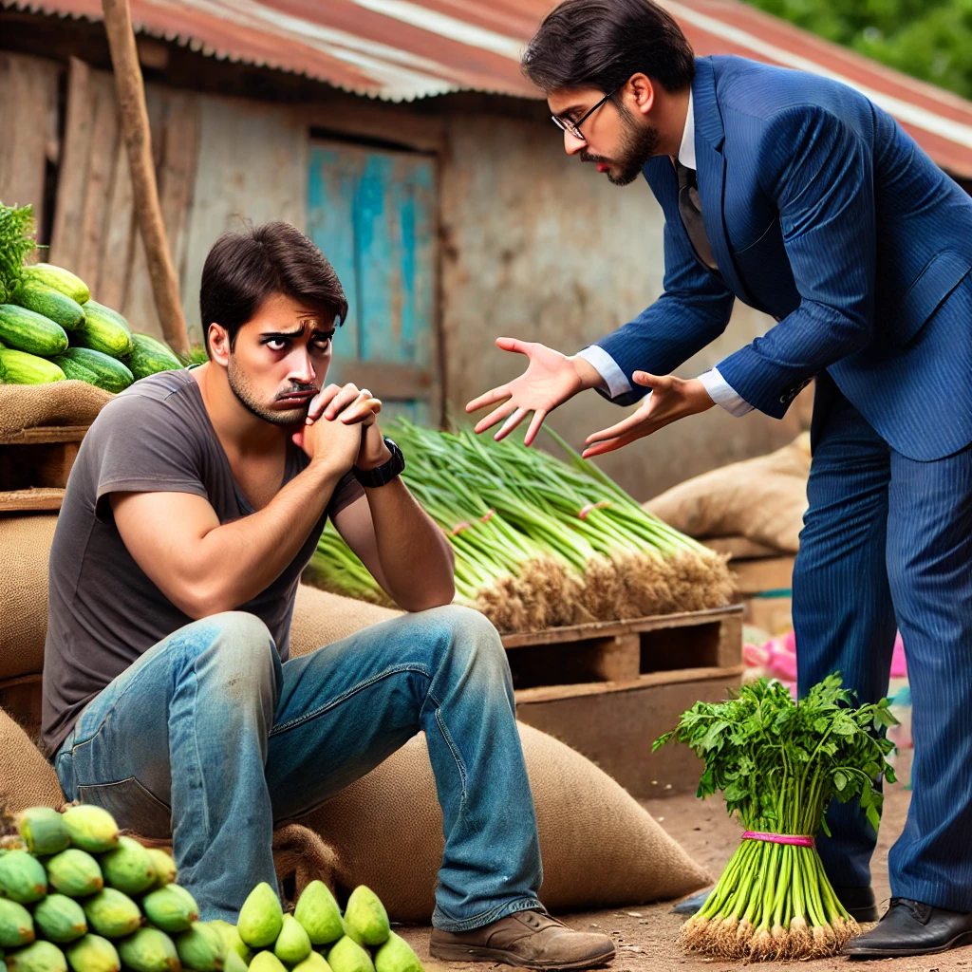
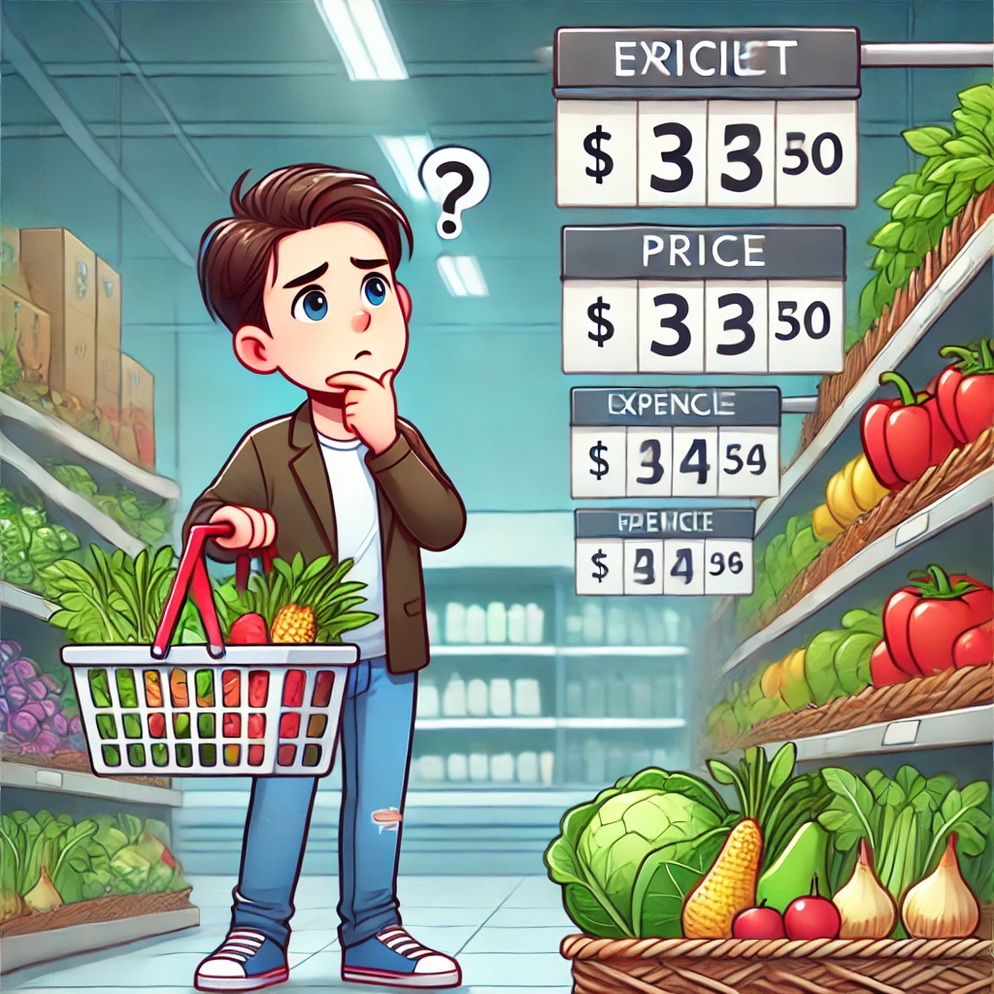
Problem Statement
Farmer Struggling to Sell Crops – Depicting frustration in a rural marketplace.
Consumer Buying Expensive Vegetables – Showing surprise at high supermarket prices
Farmers lose up to 40% of their earnings due to middlemen.
The gap between farmers and consumers is hurting both!

Slide 3
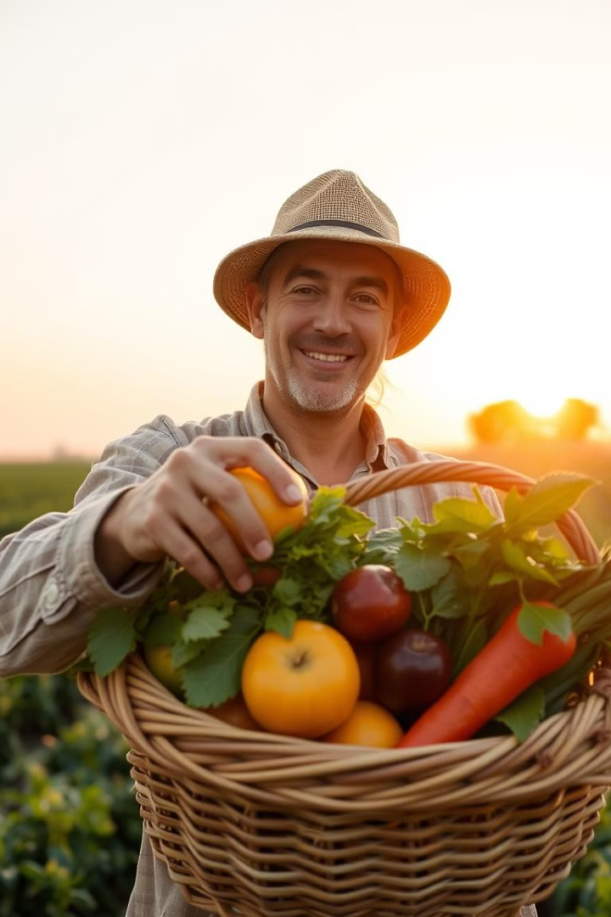
Our Solution?
Connecting Farmers to Consumers:
“Kissan Connect”
Introducing a mobile app that empowers farmers and connects them directly with consumers. This innovative platform allows farmers to access a wider market, sell their produce at better prices, and gain valuable market insights.
~ by Coder Sena

Slide 4

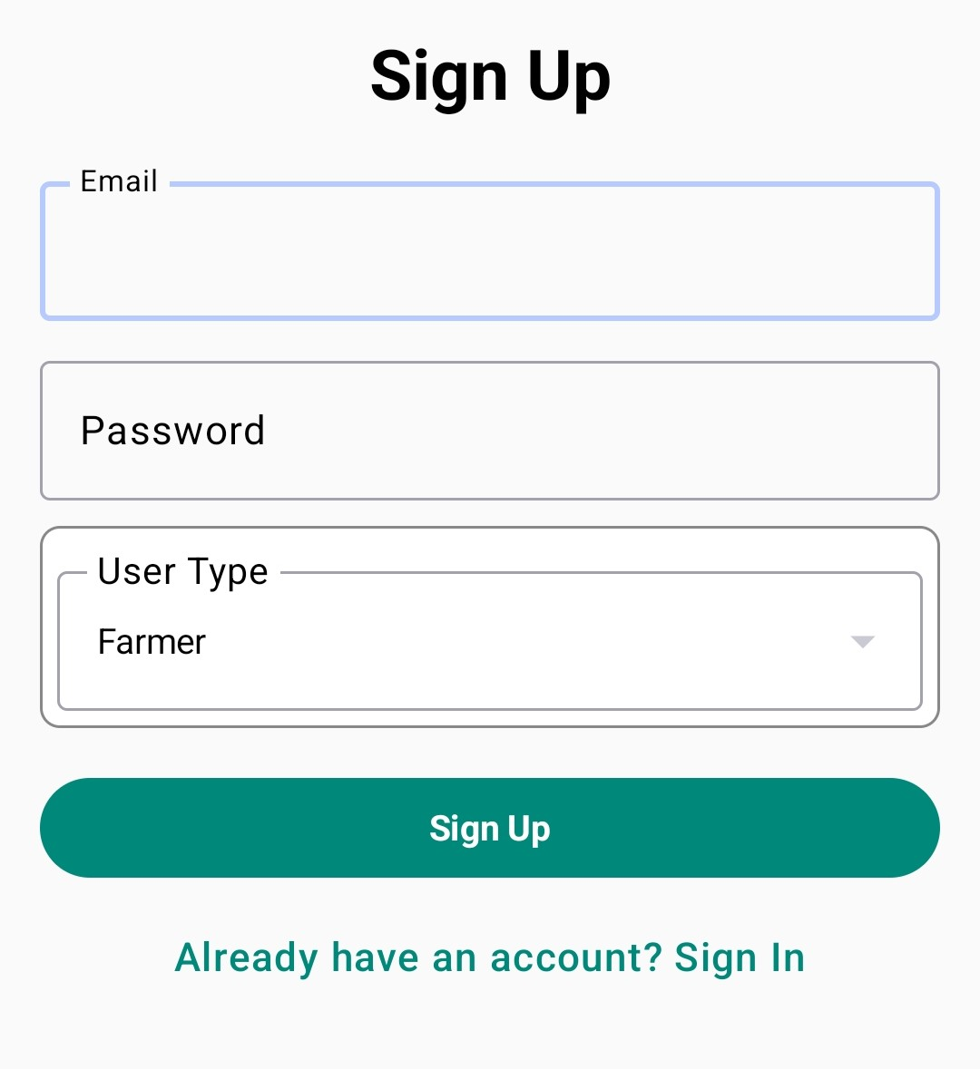
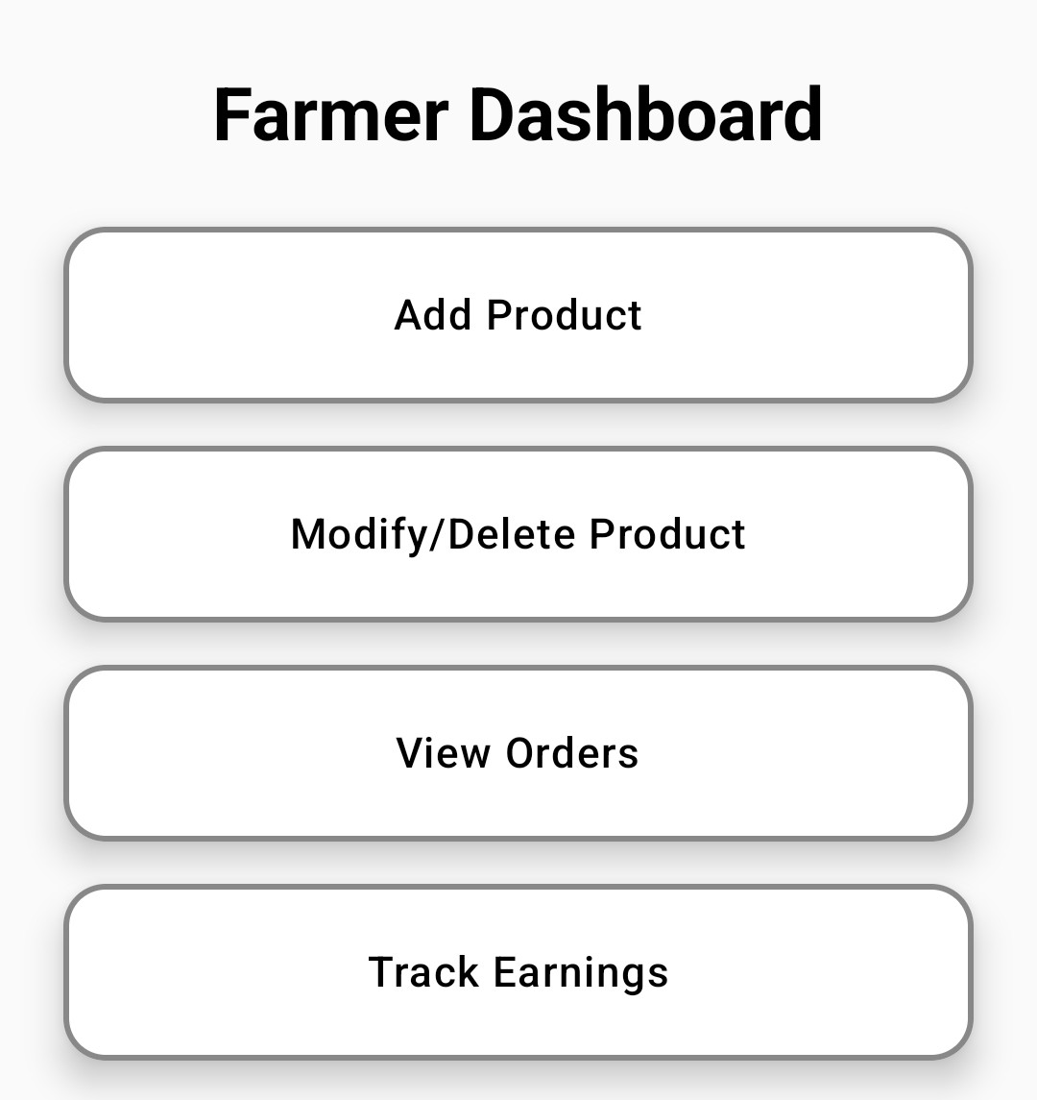
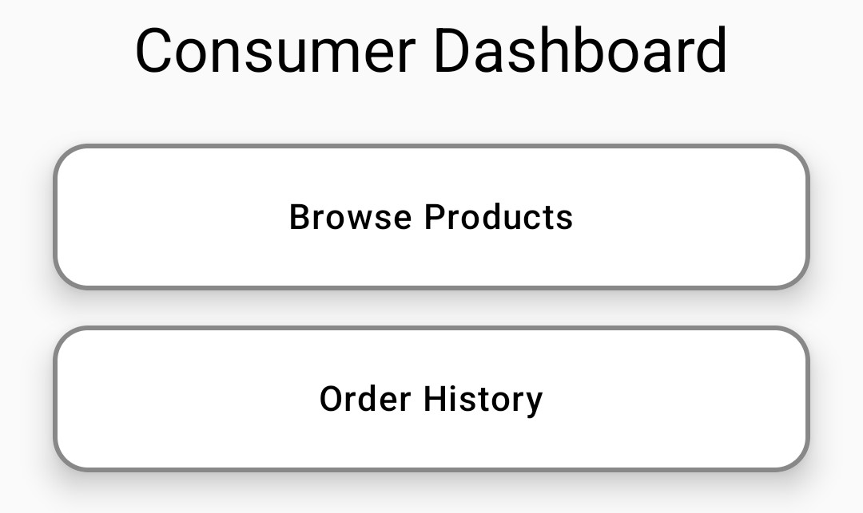
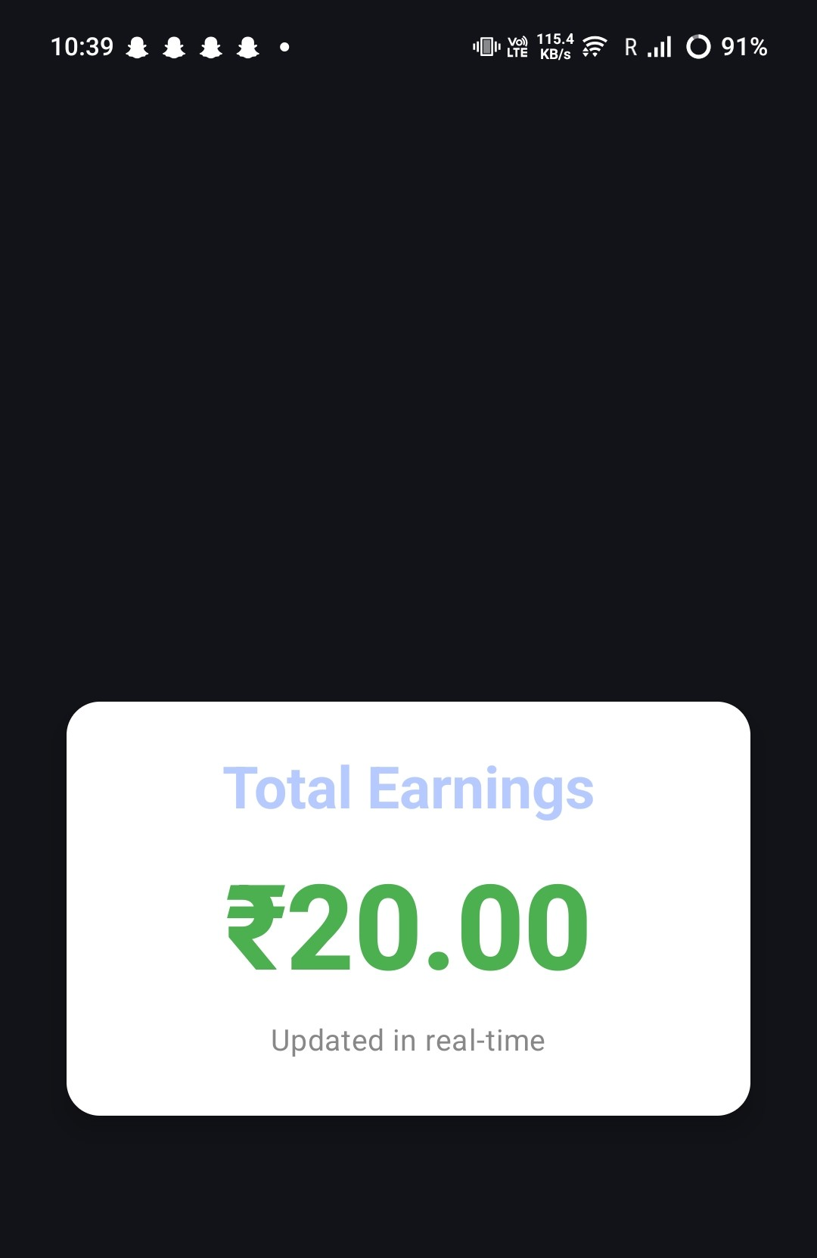
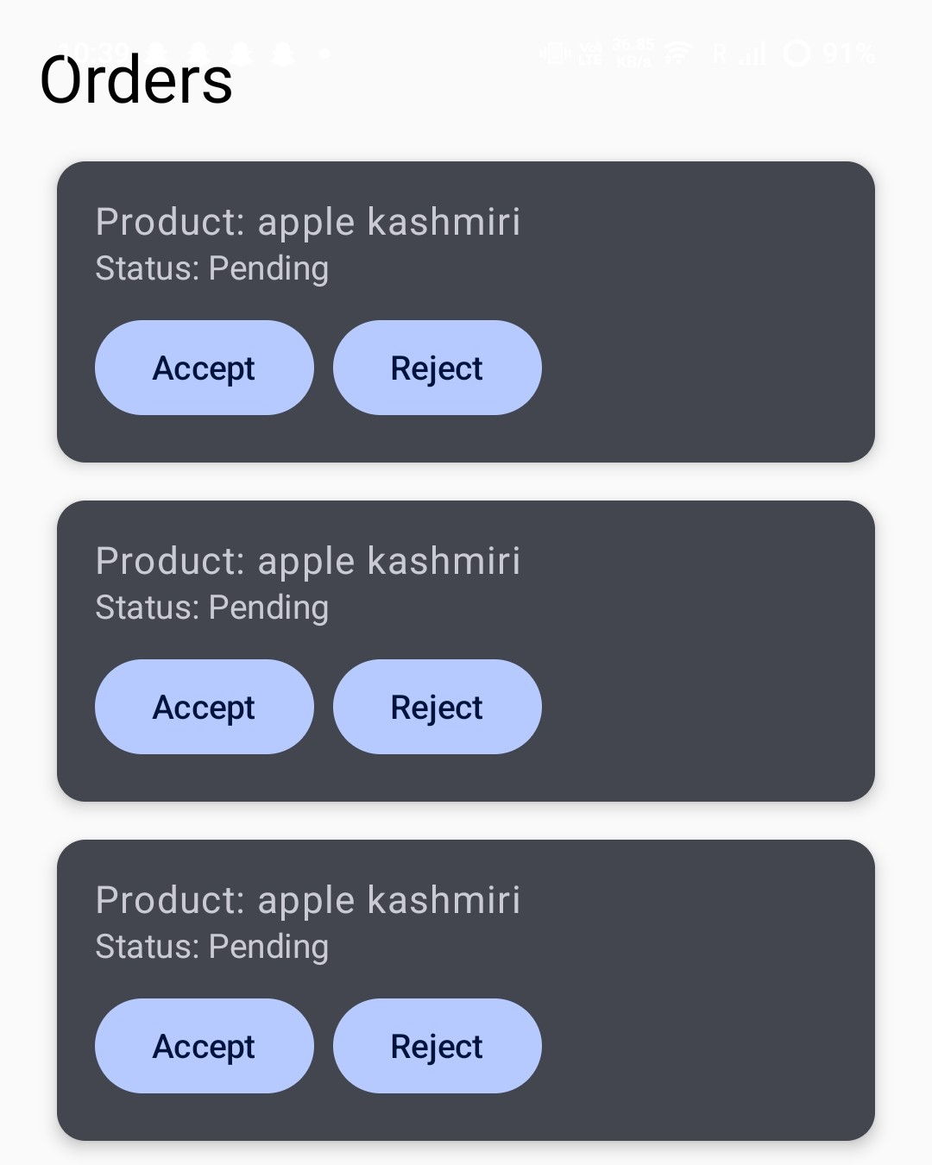
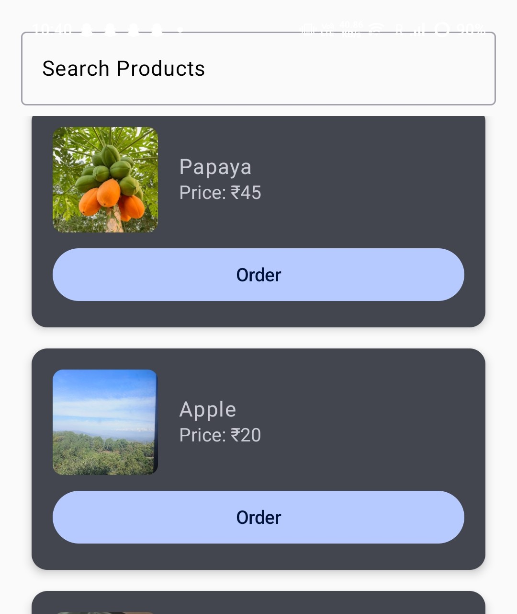
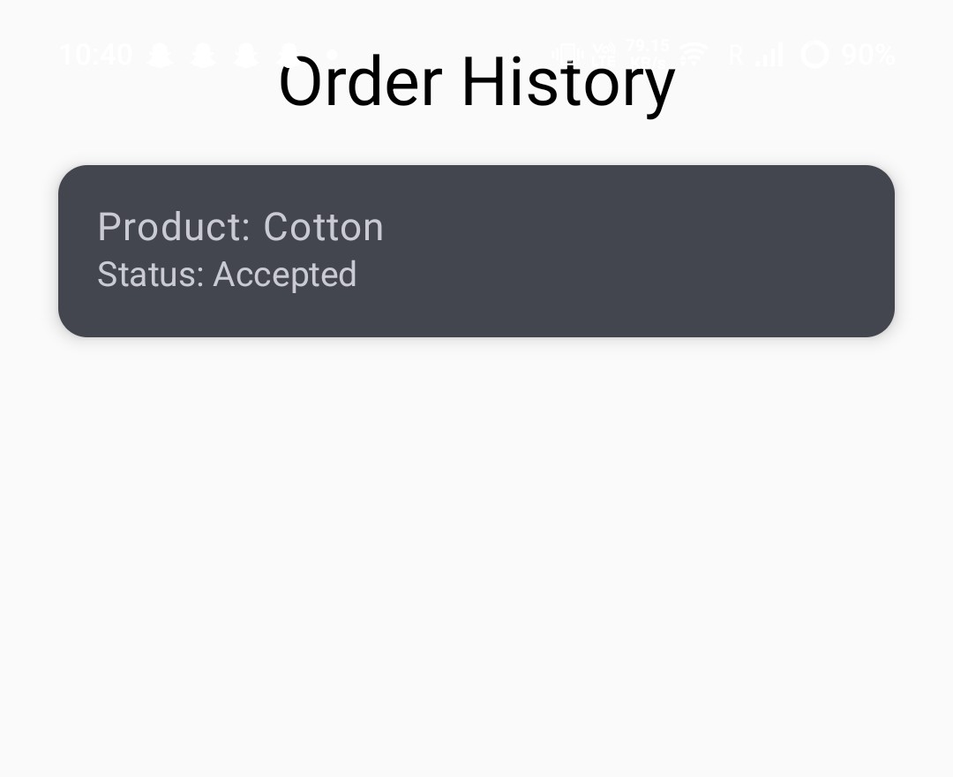
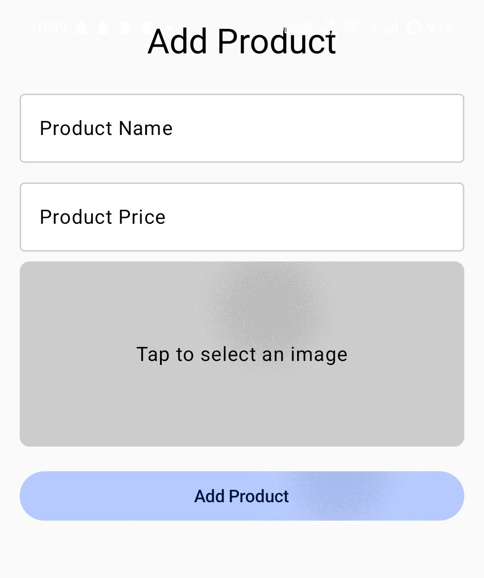
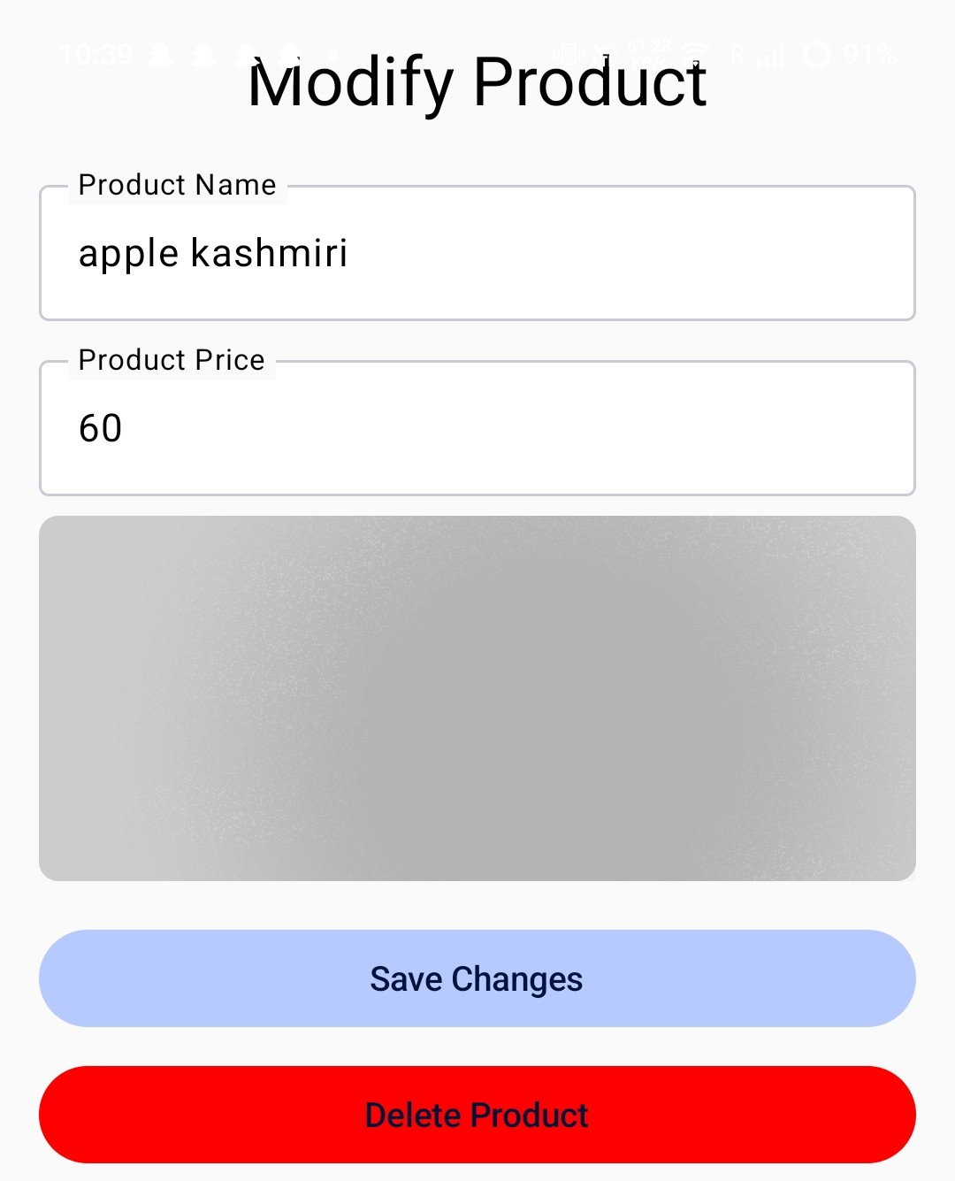
User-Friendly Interface
Kissan Connect
Login features
Farmer’s Dashboard
Consumer’s Dashboard
Product Management
Track Earnings
Order Details
View Products
Order History

Slide 5
Farmers: Empowering Your Growth
Wider Reach
Higher Profits
Easy UI
Connect with a larger customer base beyond local markets.
Earn better prices by cutting out middlemen.
An easy and user-friendly Interface for simplicity.

Slide 6
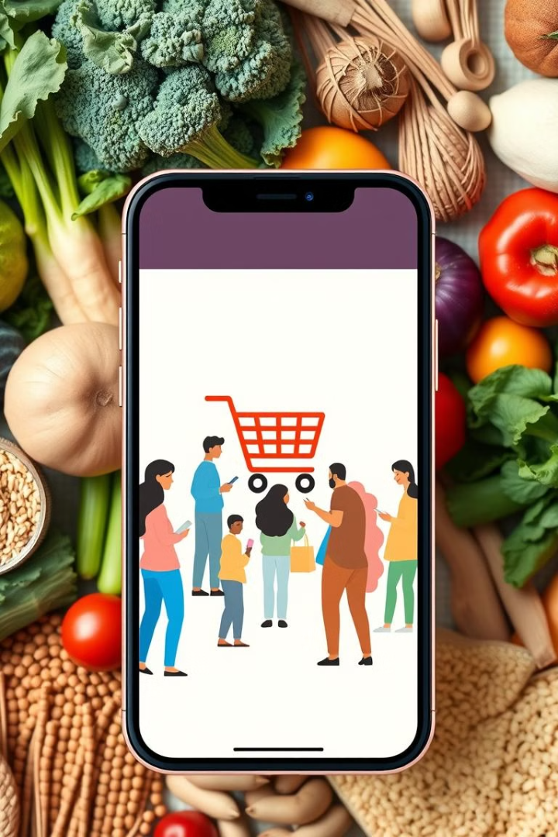
Consumers: Enjoy Fresh, Local Produce
Fresh & Local
Supporting Local Farmers
Source fresh, high-quality produce directly from farmers.
Contribute to the sustainability of local agriculture and community.

Slide 7
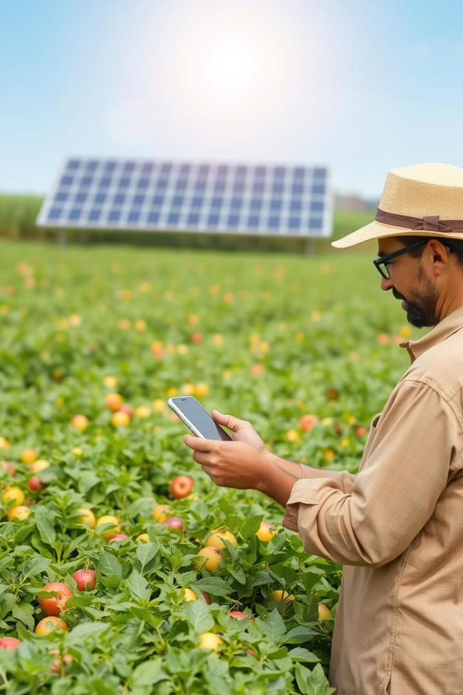

Promoting Sustainable Agriculture
Environmental Impact
Fair Pricing
Promoting local food systems by showing the farmers that are nearby consumer’s location.
Farmers receive better prices, encouraging sustainable farming practices.

Slide 8

User-Friendly Interface and Easy Navigation
Multilingual Support
Intuitive Design
Access the app in your preferred language for convenient use.
Simple Registration
Navigate the app seamlessly and find what you need with ease.
Sign up easily with basic information and verify your account.

Slide 9
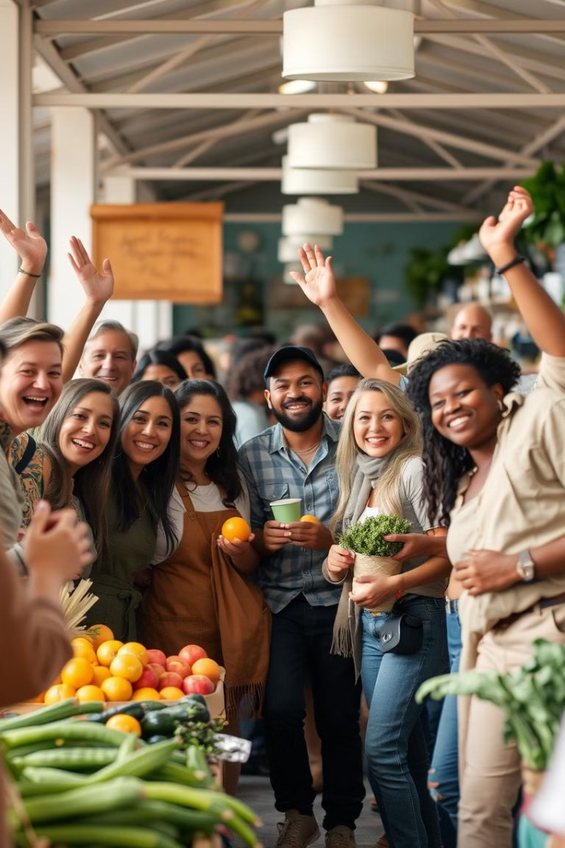
Empowering Farmers, Connecting Communities
Our mobile app empowers farmers to control their futures by providing them with direct access to consumers, enabling a fair and sustainable market.
Eliminates Middlemen and promotes farmers for better profits.

Slide 10

Features To Be Added
AI Scanning: Add products by scanning the item.
Icons: icons to be added for more simpler UI interface for farmers like for add products, icon could be used…
Dark mode: Dark mode for relaxation to the eyes for the users.
Logistic Features: We want to add logistic features in future if this model successfully worked.

Slide 11
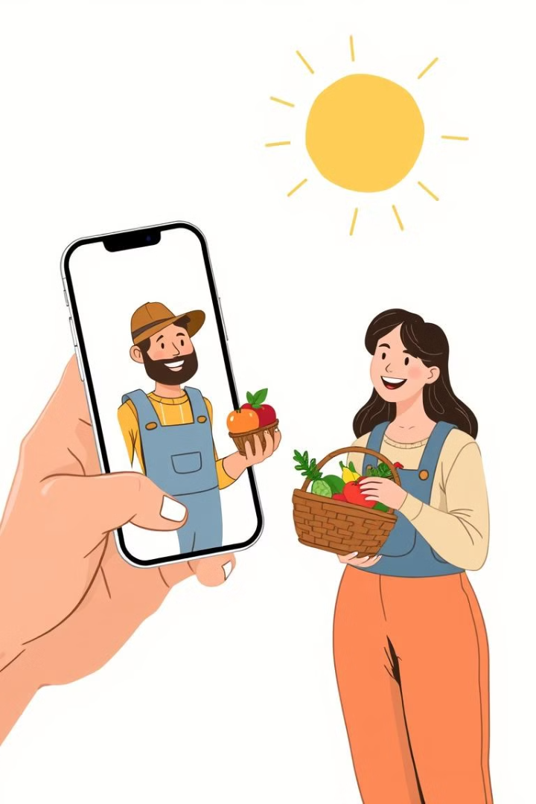
Join the Movement!
Support Farmers.
Get Fresh Food.
Download the app today and be part of a movement that connects farmers and consumers, fostering a thriving agricultural community.

Slide 12
